Slide 1
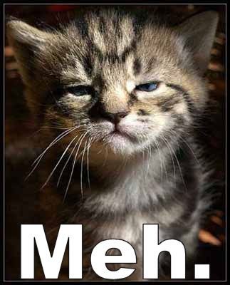
Have you ever felt like your writing was… well…

Slide 2
Variety in your sentences…
engages your audience
makes your writing more interesting
provides focus and power to your ideas and purpose

Slide 3
Parallel Structure for
grace, style, rhythm and Sophistication
Parallel structure means using the same pattern of words to show that two or more ideas have the same level of importance.
This can happen at the word, phrase, or clause level. The usual way to join parallel structures is with the use of coordinating conjunctions such as "and" or "or."

Slide 4
Parallel Structure for
grace, style, rhythm and Sophistication
This can happen at the word, phrase, or clause level.
A phrase is a group of words that does NOT contain a subject and a predicate, while a clause contains a subject and a predicate.
James ran home. (independent clause)
After James ran home. (dependent clause)
With the red Corvette. (phrase)

Slide 5
Parallel Structure
President Barack Obama's inaugural remarks on Jan. 20, 2009, at the United States Capitol in Washington, D.C. http://www.huffingtonpost.com/2009/01/20/president-obamas-inaugura_n_159370.html
My fellow citizens:
I stand here today humbled by the task before us, grateful for the trust you have bestowed, mindful of the sacrifices borne by our ancestors. I thank President Bush for his service to our nation, as well as the generosity and cooperation he has shown throughout this transition.
Forty-four Americans have now taken the presidential oath. The words have been spoken during rising tides of prosperity and the still waters of peace. Yet, every so often the oath is taken amidst gathering clouds and raging storms. At these moments, America has carried on not simply because of the skill or vision of those in high office, but because We the People have remained faithful to the ideals of our forbearers, and true to our founding documents.

Slide 6
Parallel Structure
President Barack Obama's inaugural remarks on Jan. 20, 2009, at the United States Capitol in Washington, D.C. http://www.huffingtonpost.com/2009/01/20/president-obamas-inaugura_n_159370.html
My fellow citizens:
I stand here today humbled by the task before us, grateful for the trust you have bestowed, mindful of the sacrifices borne by our ancestors. I thank President Bush for his service to our nation, as well as the generosity and cooperation he has shown throughout this transition.
Forty-four Americans have now taken the presidential oath. The words have been spoken during rising tides of prosperity and the still waters of peace. Yet, every so often the oath is taken amidst gathering clouds and raging storms. At these moments, America has carried on not simply because of the skill or vision of those in high office, but because We the People have remained faithful to the ideals of our forbearers, and true to our founding documents.

Slide 7
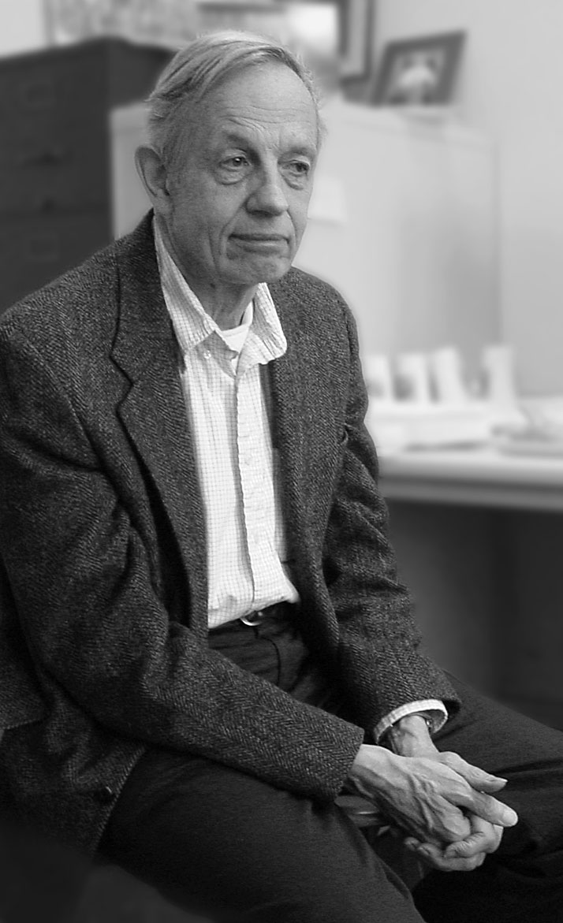
Parallel Structure
Excerpt from: John Nash, Nobel Prize Acceptance Speech:
Thank you. I've always believed in numbers and the equations and logics that lead to reason. My quest has taken me through the physical, the metaphysical, the delusional -- and back. And I have made the most important discovery of my career, the most important discovery of my life: It is only in the mysterious equations of love that any logic or reasons can be found.

Slide 8
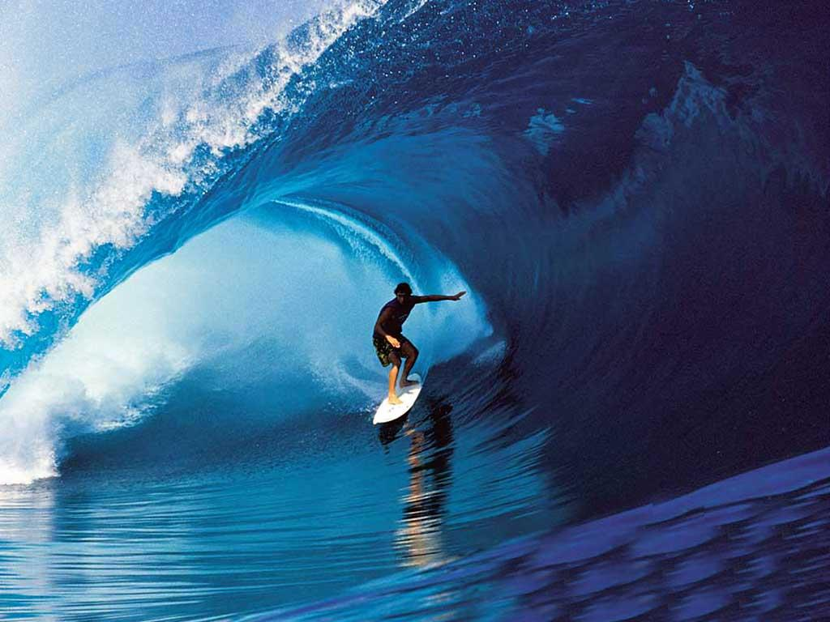
Parallel Structure
“Listen” for parallel structure

Slide 9
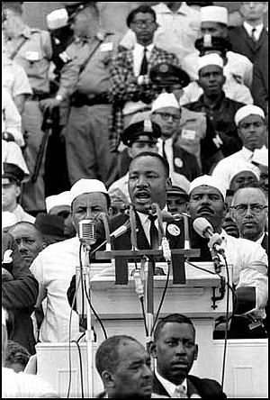
Repetition, for emphasis
Excerpt from “I Have A Dream” speech – M.L. King, Jr.
And so let freedom ring from the prodigious hilltops of New Hampshire.
Let freedom ring from the mighty mountains of New York.
Let freedom ring from the heightening Alleghenies of Pennsylvania.
Let freedom ring from the snow-capped Rockies of Colorado.
Let freedom ring from the curvaceous slopes of California.
Full copy of the speech can be found here.

Slide 10
Excerpt from: The Things They Carried, by Tim O’Brien
The things they carried were largely determined by necessity…Henry Dobbins, who was a big man, carried extra rations. Dave Jensen, who practiced field hygiene, carried a toothbrush, dental floss and several hotel-sized bars of soap. Ted Lavender, who was scared, carried tranquilizers until he was shot in the head outside the village of Than Khe in mid-April. By necessity…they all carried steel helmets that weighed 5 pounds including the liner and camouflage cover. They carried the standard fatigue jackets and trousers. On their feet they carried jungle boots – 2.1 pounds – and Dave Jensen carried three pairs of socks and a can of Dr. Scholl’s foot powder as a precaution against trench foot….Norman Bowker carried a diary. Rat Killy carried comic books.
They carried memories
They carried the emotional baggage of men and women who might die at any moment. They carried the weight of the world. THEY CARRIED EACH OTHER

Slide 11
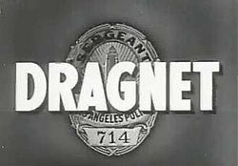
Staccato sentence
In music, staccato means “to cut short, crisply,” to create emphasis, to break a pattern to capture the audience’s attention.
Staccato sentences have a similar purpose in writing. Short, simple, yet powerful sentences, strategically situated in a selection break patterns. When patterns are broken, we pay attention.

Slide 12
Student sample:
The day we found out about Granddad Jim’s cancer, I sat at the foot of my parents’ bed with my mouth pressed into a thin line, trying to blink away the tears. My mother and sister bawled, my father sat stiffly against the headboard wearing the same expression as me, and my brother blinked owlishly from under his curly brown hair, looking far younger than he should. That morning I silently made breakfast. Everything tasted grey.

